Slide 1



Employment Services System of South Africa
ESSA – Online
STEP BY STEP GUIDE FOR EMPLOYERS AND WORKSEEKERS TO REGISTER AND RENEW PASSWORDS

Slide 2


Slide 3
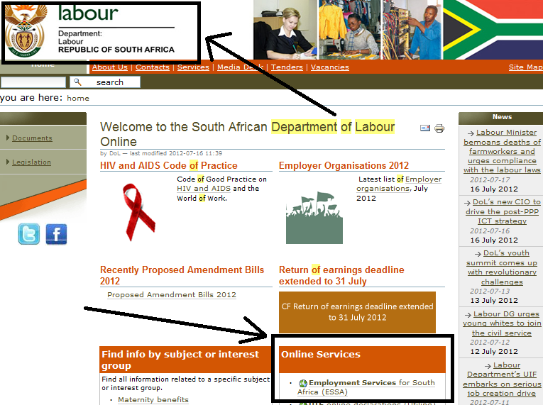
STEP1:
Go to www.labour.gov.za, go to Online Services, then go to Employment Services for South Africa (ESSA)

Slide 4
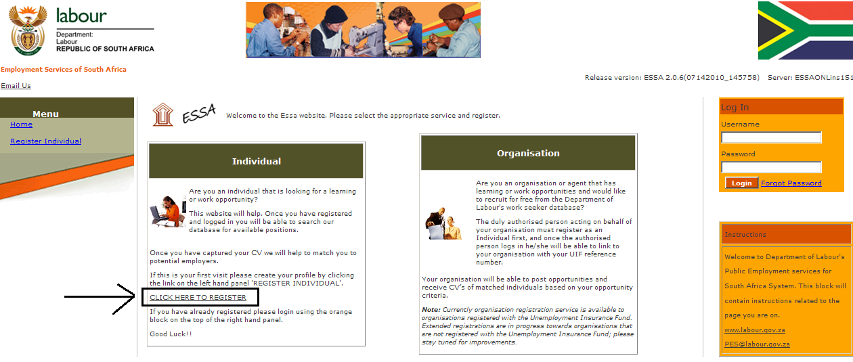
STEP 2:
Go to INDIVIDUAL: CLICK HERE TO REGISTER

Slide 5
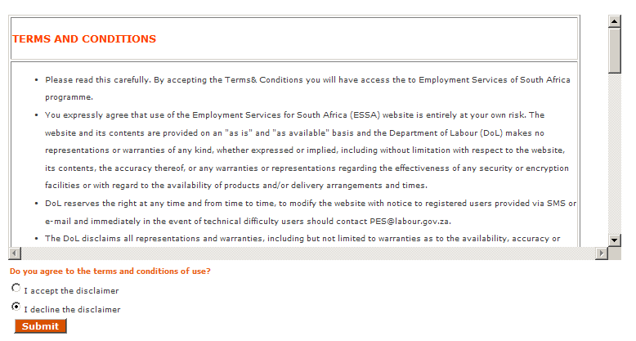
STEP 3: Accept the disclaimer

Slide 6
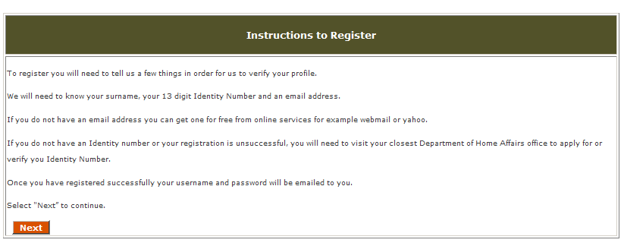
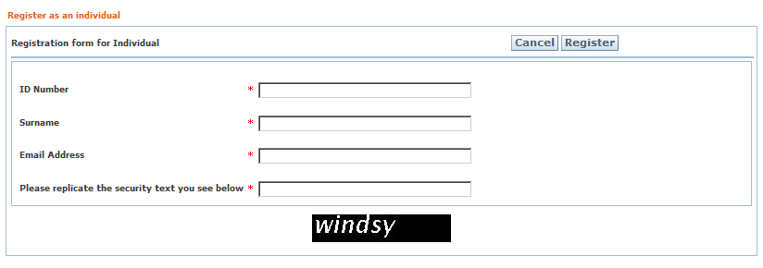
STEP 4: Instructions to register

Slide 7
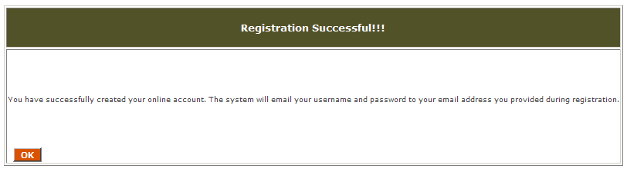
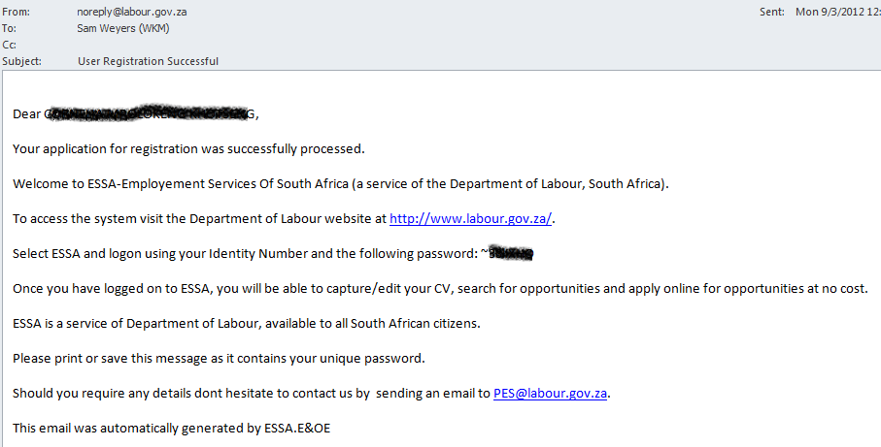
NOTIFICATION OF REGISTRATION –E-MAIL
Organisation / Individual MUST have an email address

Slide 8
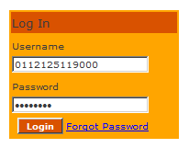
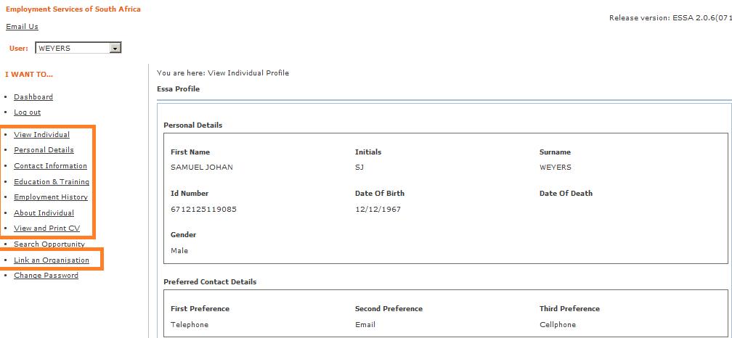
STEP 5: Gain access to ESSA
← Identity number
← Secret Password (E-mail)
VIEW Profile

Slide 9
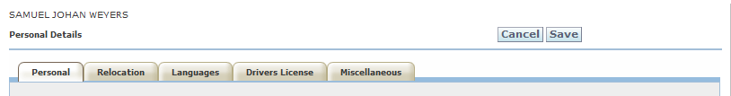
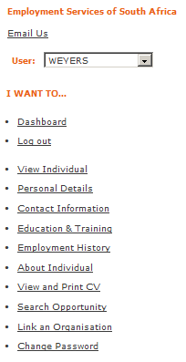
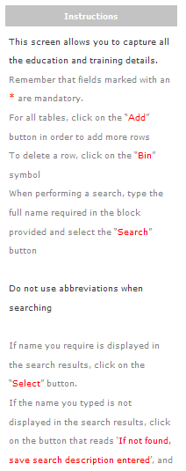
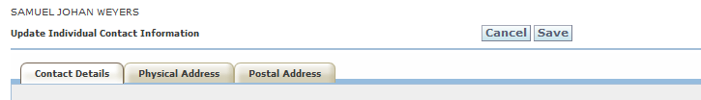
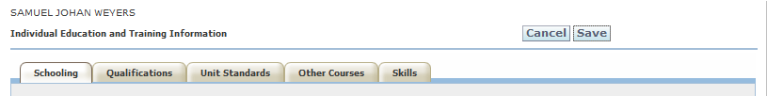
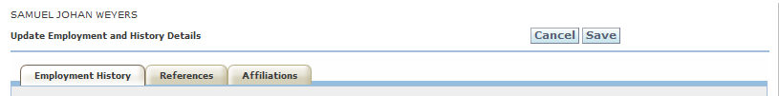
STEP 6: Update Profile
I WANT TO…
WORKSPACE
INSTRUCTIONS

Slide 10
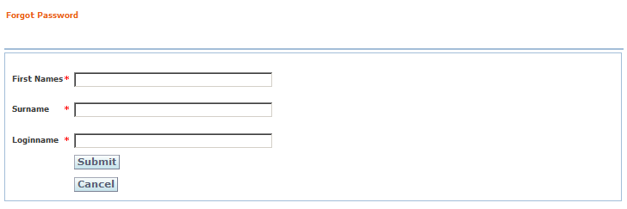
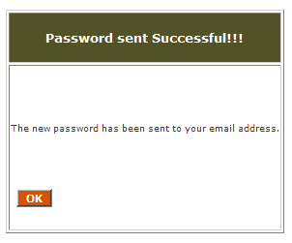
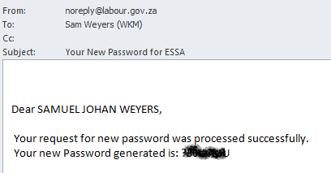
FORGOT PASSWORD

Slide 11
Key Business Rules for Using Online ESSA Services:
All Clients registering must have a valid ID number and email account, available on the day of registration.
Be able to read and follow instructions as per prompt.
Write down the password contained in the system generated letter.
Store in a safe place for future usage.
Clients are most welcome to change the initial password, by following the forgot password prompt.

